Slide 1
Module – 13 Cloud Computing
Module 13: Cloud Computing
1
Notes:
Module – 13
Cloud Computing

Slide 2
Module 13: Cloud Computing
Upon completion of this module, you should be able to:
Explain the characteristics of cloud computing
Describe cloud services and deployment models
Describe cloud computing infrastructure
Discuss the challenges of cloud computing
Discuss cloud adoption considerations

Slide 3
Module 13: Cloud Computing
Lesson 1: Cloud Computing Overview
During this lesson the following topics are covered:
Definition of cloud computing
Essential characteristics of cloud computing
Benefits of cloud computing
Cloud enabling technologies

Slide 4
Drivers for Cloud Computing
Business requirements
Transformation of IT processes to achieve more with less
Better agility and higher availability at reduced expenditure
Reduced time-to-market
Accelerated pace of innovation
IT challenges to meet business requirements are:
Serving customers worldwide round the clock, refreshing technology quickly, faster provisioning of IT resources – all at reduced cost
These challenges are addressed with the emergence of cloud computing

Slide 5
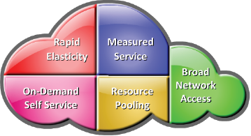
What is Cloud Computing?
Cloud Computing
A model for enabling ubiquitous, convenient, on-demand network access to a shared pool of configurable computing resources (e.g., servers, storage, networks, applications, and services) that can be rapidly provisioned and released with minimal management effort or service provider interaction.
– NIST
Essential Cloud characteristics
On-demand self-service
Broad network access
Resource pooling
Rapid elasticity
Measured service

Slide 6
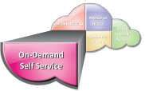
On-demand Self-service
Enables consumers to unilaterally provision computing capabilities (examples: server time and storage capacity) as needed automatically
Consumers view service catalogue via a Web-based user interface and use it to request for a service

Slide 7

Broad Network Access
Computing capabilities are available over the network
Computing capabilities are accessed from a broad range of client platforms such as:
Desktop computer
Laptop
Tablet
Mobile device

Slide 8
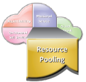
Resource Pooling
Provider’s computing resources are pooled to serve multiple consumers using a multitenant model
Resources are assigned from the pool according to consumer demand
Consumers have no control or knowledge over the exact location of the provided resources

Slide 9
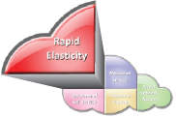
Rapid Elasticity
Computing capabilities can be elastically provisioned and released
Computing capabilities are scaled rapidly, commensurate with consumer’s demand
Provides a sense of unlimited scalability

Slide 10
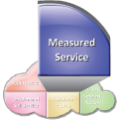
Measured Service
Cloud computing provides a metering system that continuously monitors resource consumption and generates reports
Helps to control and optimize resource use
Helps to generate billing and chargeback reports

Slide 11
Benefits of Cloud Computing
Benefits | Description
Reduced IT cost | Reduces the up-front capital expenditure (CAPEX)
Business agility | Provides the ability to deploy new resources quickly Enables businesses to reduce time-to-market
Flexible scaling | Enables consumers to scale up, scale down, scale out, or scale in the demand for computing resources easily Consumers can unilaterally and automatically scale computing resources
High availability | Ensures resource availability at varying levels, depending on consumer’s policy and priority

Slide 12
Cloud Enabling Technologies
Technologies | Description
Grid computing | Form of distributed computing Enables resources of numerous computers in a network to work on a single task at the same time
Utility computing | Service provisioning model that offers computing resources as a metered service
Virtualization | Abstracts physical characteristics of IT resources from resource users Enables resource pooling and creating virtual resources from pooled resources
Service-oriented architecture (SOA) | Provides a set of services that can communicate with each other

Slide 13
Module 13: Cloud Computing
Lesson 2: Cloud Service and Deployment Models
During this lesson the following topics are covered:
Cloud service models
Cloud deployment models

Slide 14
Cloud Service Models
Infrastructure-as-a-Service (IaaS)
Platform-as-a-Service (PaaS)
Software-as-a-Service (SaaS)

Slide 15

Infrastructure-as-a-Service
Consumers deploy their software, including OS and application on provider’s infrastructure
Computing resources such as processing power, memory, storage, and networking components are offered as service
Example: Amazon Elastic Compute Cloud
Consumers have control over the OSs and deployed applications
Consumer’s Resources
Application
Database
OS
Provider’s Resources
Compute
Storage
Cloud
Network

Slide 16
Platform-as-a-Service
Consumers deploy consumer-created or acquired applications onto provider’s computing platform
Computing platform is offered as a service
Example: Google App Engine and Microsoft Windows Azure Platform
Consumer has control over deployed applications
Consumer’s Resources
Application
Database
Provider’s Resources
OS
Compute
Storage
Cloud
Network

Slide 17
Software-as-a-Service
Consumers use provider’s applications running on the cloud infrastructure
Applications are offered as a service
Examples: EMC Mozy and Salesforce.com
Service providers exclusively manage computing infrastructure and software to support services
Application
Database
Provider’s Resources
OS
Compute
Storage
Cloud
Network

Slide 18
Cloud Deployment Models
Public
Private
Community
Hybrid

Slide 19
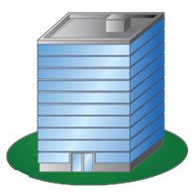
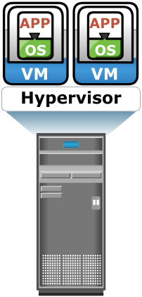
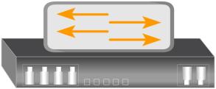
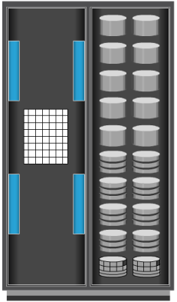
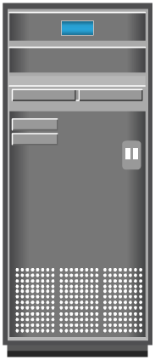

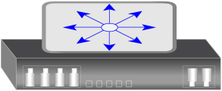
Public Cloud
Enterprise P
Enterprise Q
Cloud Service Provider’s Resources
User R

Slide 20
Private Cloud
On-Premise Private Cloud
Externally Hosted Private Cloud
Enterprise P
Enterprise P
Resources of
Enterprise P
Cloud Service
Provider’s Resources
Dedicated for
Enterprise P

Slide 21
Community Cloud
Community Users
Enterprise P
Enterprise Q
Enterprise R
Cloud Service Provider’s Resources
Dedicated for Community Users

Slide 22
Hybrid Cloud
Enterprise Q
Enterprise P
Cloud Service Provider’s Resources
Resources of
Enterprise P
Public Cloud
Private Cloud
User R

Slide 23
Module 13: Cloud Computing
Lesson 3: Cloud Infrastructure, Challenges, and Considerations
During this lesson the following topics are covered:
Cloud infrastructure
Challenges of cloud computing
Cloud adoption considerations

Slide 24



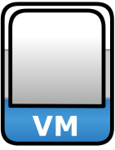

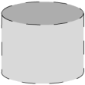
Cloud Infrastructure Framework
Cloud Management and Service Creation Tools
Applications and Platform Software
Virtual
Infrastructure
Physical
Infrastructure

Slide 25
Physical Infrastructure
Physical infrastructure includes physical IT resources
Physical servers
Storage systems
Networks
Physical servers are connected to each other, to the storage systems, and to clients via networks
Physical resources may be located in a single data center or distributed across multiple data centers

Slide 26
Virtual Infrastructure
Virtual infrastructure consists of:
Resource pools
CPU, memory, network bandwidth, storage pools
Identity pools
VLAN ID and VSAN ID pools
Virtual IT resources
Virtual Machines (VMs), virtual storage volumes, virtual networks (VLAN and VSAN)
Virtual IT resources obtain capacity and identity from resource and identity pools respectively

Slide 27
Applications and Platform Software
Suite of software that may include:
Business applications
Platform software such as OS and database
Provide environments for applications to run
Applications and platform software are hosted on VMs
To create software-as-a-service (SaaS) and platform-as-a-service (PaaS)

Slide 28
Cloud Management and Service Creation Tools
Include three types of software:
Physical and virtual infrastructure management software
Unified management software
User-access management software
These software interact among themselves to automate provisioning of cloud services

Slide 29
Cloud-optimized Storage
Provides rapid elasticity, global access, and storage capacity on-demand
Leverages object-based storage technology
Enables self-service and fully metered access to storage resources
Key characteristics of cloud-optimized storage solution are:
Massively scalable
Unified namespace
Metadata and policy-based information management
Secure multitenancy
Multiple access mechanisms (through REST and SOAP web service APIs and file-based access)

Slide 30
Cloud Challenges – Consumer’s Perspective
Security and regulation
Consumers are indecisive to transfer control of sensitive data
Regulation may prevent organizations to use cloud services
Network latency
Real time applications may suffer due to network latency and limited bandwidth
Supportability
Service provider might not support proprietary environments
Incompatible hypervisors could impact VM migration
Vendor lock-in
Restricts consumers from changing their cloud service providers
Lack of standardization across cloud-based platforms

Slide 31
Cloud Challenges – Provider’s Perspective
Service warranty and service cost
Resources must be kept ready to meet unpredictable demand
Hefty penalty, if SLAs are not fulfilled
Complexity in deploying vendor software in the cloud
Many vendors do not provide cloud-ready software licenses
Higher cost of cloud-ready software licenses
No standard cloud access interface
Cloud consumers want open APIs
Need agreement among cloud providers for standardization

Slide 32
Cloud Adoption Considerations
CIOs/IT Managers seeking to move to the cloud face several questions:
Which deployment model fits organization’s requirements?
Private, public, hybrid
Which are the applications suitable for cloud?
How do I choose the cloud service provider?
Is the cloud infrastructure capable of providing the required Quality of Service (QoS)?
Performance, availability, and security
What is the financial benefit in adopting cloud?

Slide 33


What Deployment Model Fits for You?
Individual
Startup
SMB
Enterprise
Public cloud
Convenience outweighs risk
Low cost or free
Ex: Picasa, Google apps
Hybrid cloud
Tier 1 apps: private cloud
Tier 2-4 apps (backup, archive, testing): public cloud
Public cloud
Convenience outweighs risk
Private cloud
Tier 2-4: private cloud
Tier 1: may continue to run in a traditional data center environment

Slide 34
Choosing Applications for Public Cloud
Some key questions to ask before migrating a consumer application to the public cloud:
Is the application compatible to cloud platform software? Is it a legacy application?
Is the application proprietary and mission-critical? Does the application provide competitive advantage?
Is the application workload network traffic intensive? Will application performance be impacted by network latency and limited network bandwidth?
Does the application communicate with other data center resources or applications?

Slide 35
Financial Advantage
Require analysis of financial benefits in adopting cloud
Consider CAPEX and OPEX to deploy and maintain own infrastructure versus cloud-adoption cost
Cost of Owning Infrastructure |  | Cloud Adoption Cost
CAPEX | OPEX | OPEX
Servers Storage Operating system (OS) Application Network equipments Real estate | Power and cooling Personnel Bandwidth Maintenance Support Backup | Migration Compliance and security Subscription fee

Slide 36
Selecting a Public Cloud Service Provider
Some key questions to ask before selecting a provider:
How long and how well has the provider been delivering the services?
How well does the provider meet the organization’s current and future requirements?
How easy is it to add or remove services?
How easy is it to move to another provider, when required?
What happens when the provider upgrades their software? Is it forced on everyone? Can you upgrade on your own schedule?
Does the provider offer the required security services?
Does the provider meet your legal and privacy requirements?
Does the provider have good customer service support?

Slide 37
QoS Considerations
Consumers should check whether the QoS attributes meet their requirements
SLA is a contract between the cloud service provider and consumers that defines QoS attributes
Attributes examples: throughput, uptime, and so on

Slide 38
Module 13: Cloud Computing
Concept in Practice:
Vblock

Slide 39




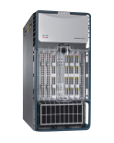
Vblock
Integrated cloud infrastructure package
Includes compute, storage, network, and virtualization products
Delivered by EMC, VMware, and Cisco
Enables building virtualized data center and cloud infrastructure
Pre-architected, preconfigured, pretested, and ready to be deployed
Saves cost and deployment time
Applications
OS
Virtualization
Compute
Network
Storage
Vblock Infrastructure Package

Slide 40
Module 13: Summary
Key points covered in this module:
Characteristics of cloud computing
Cloud services and deployment models
Cloud computing infrastructure
Challenges of cloud computing
Cloud adoption considerations

